Slide 1
Quadratic Equations Nature of their Roots
Lucan Community College
Mathematics Department
Transition Year
October 7 2009

Slide 2
Solve Algebraically
Consider the quadratic equation
If we were to solve this equation in the traditional way, be letting it equal 0, what would we get?
Try to factorise it now on your own......

Slide 3
Solve Graphically
Draw the graph of the function

Slide 4
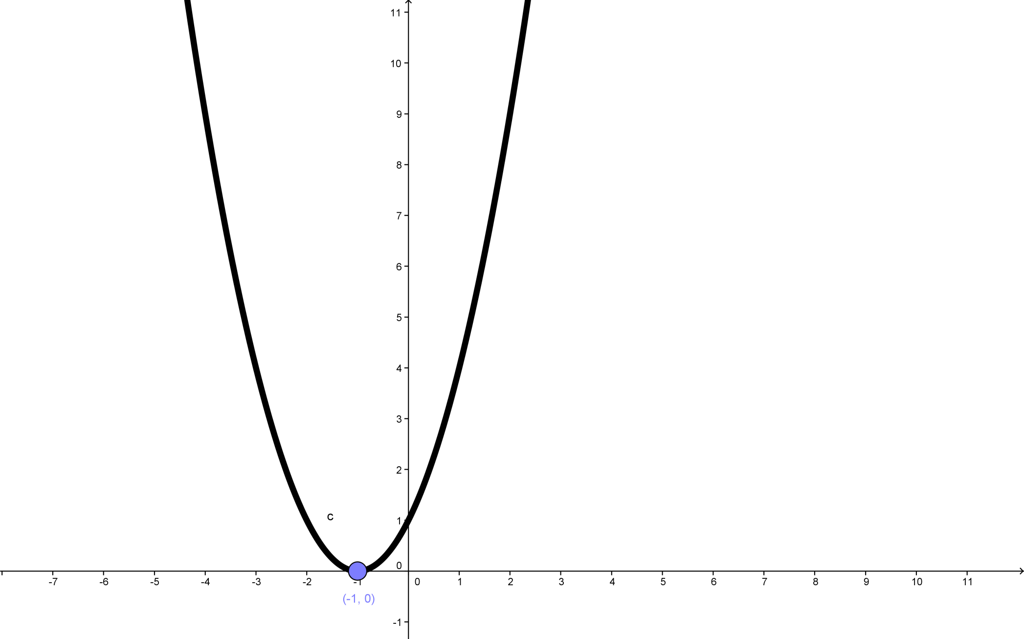

Slide 5
What do you notice?
Where does the graph cut the x-axis?
What is this point called?
Have we met this x-value anywhere else?
Why only one x-value?

Slide 6
Another function - algebraically
Solve

Slide 7
And graphically
Based on our previous example what do you expect to happen?
Where will the graph cut the x-axis?

Slide 8
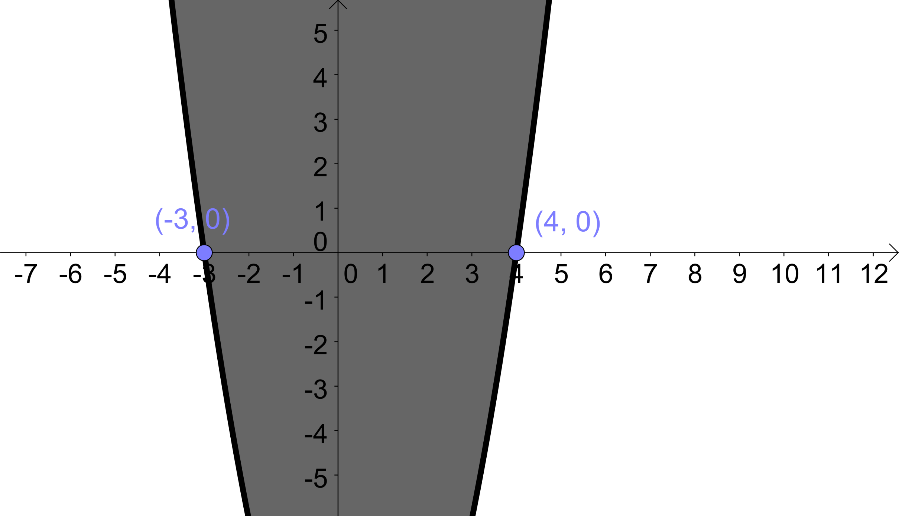

Slide 9
Did we get what you expected?
Finally, look at the following quadratic equation
Draw the graph of this function

Slide 10
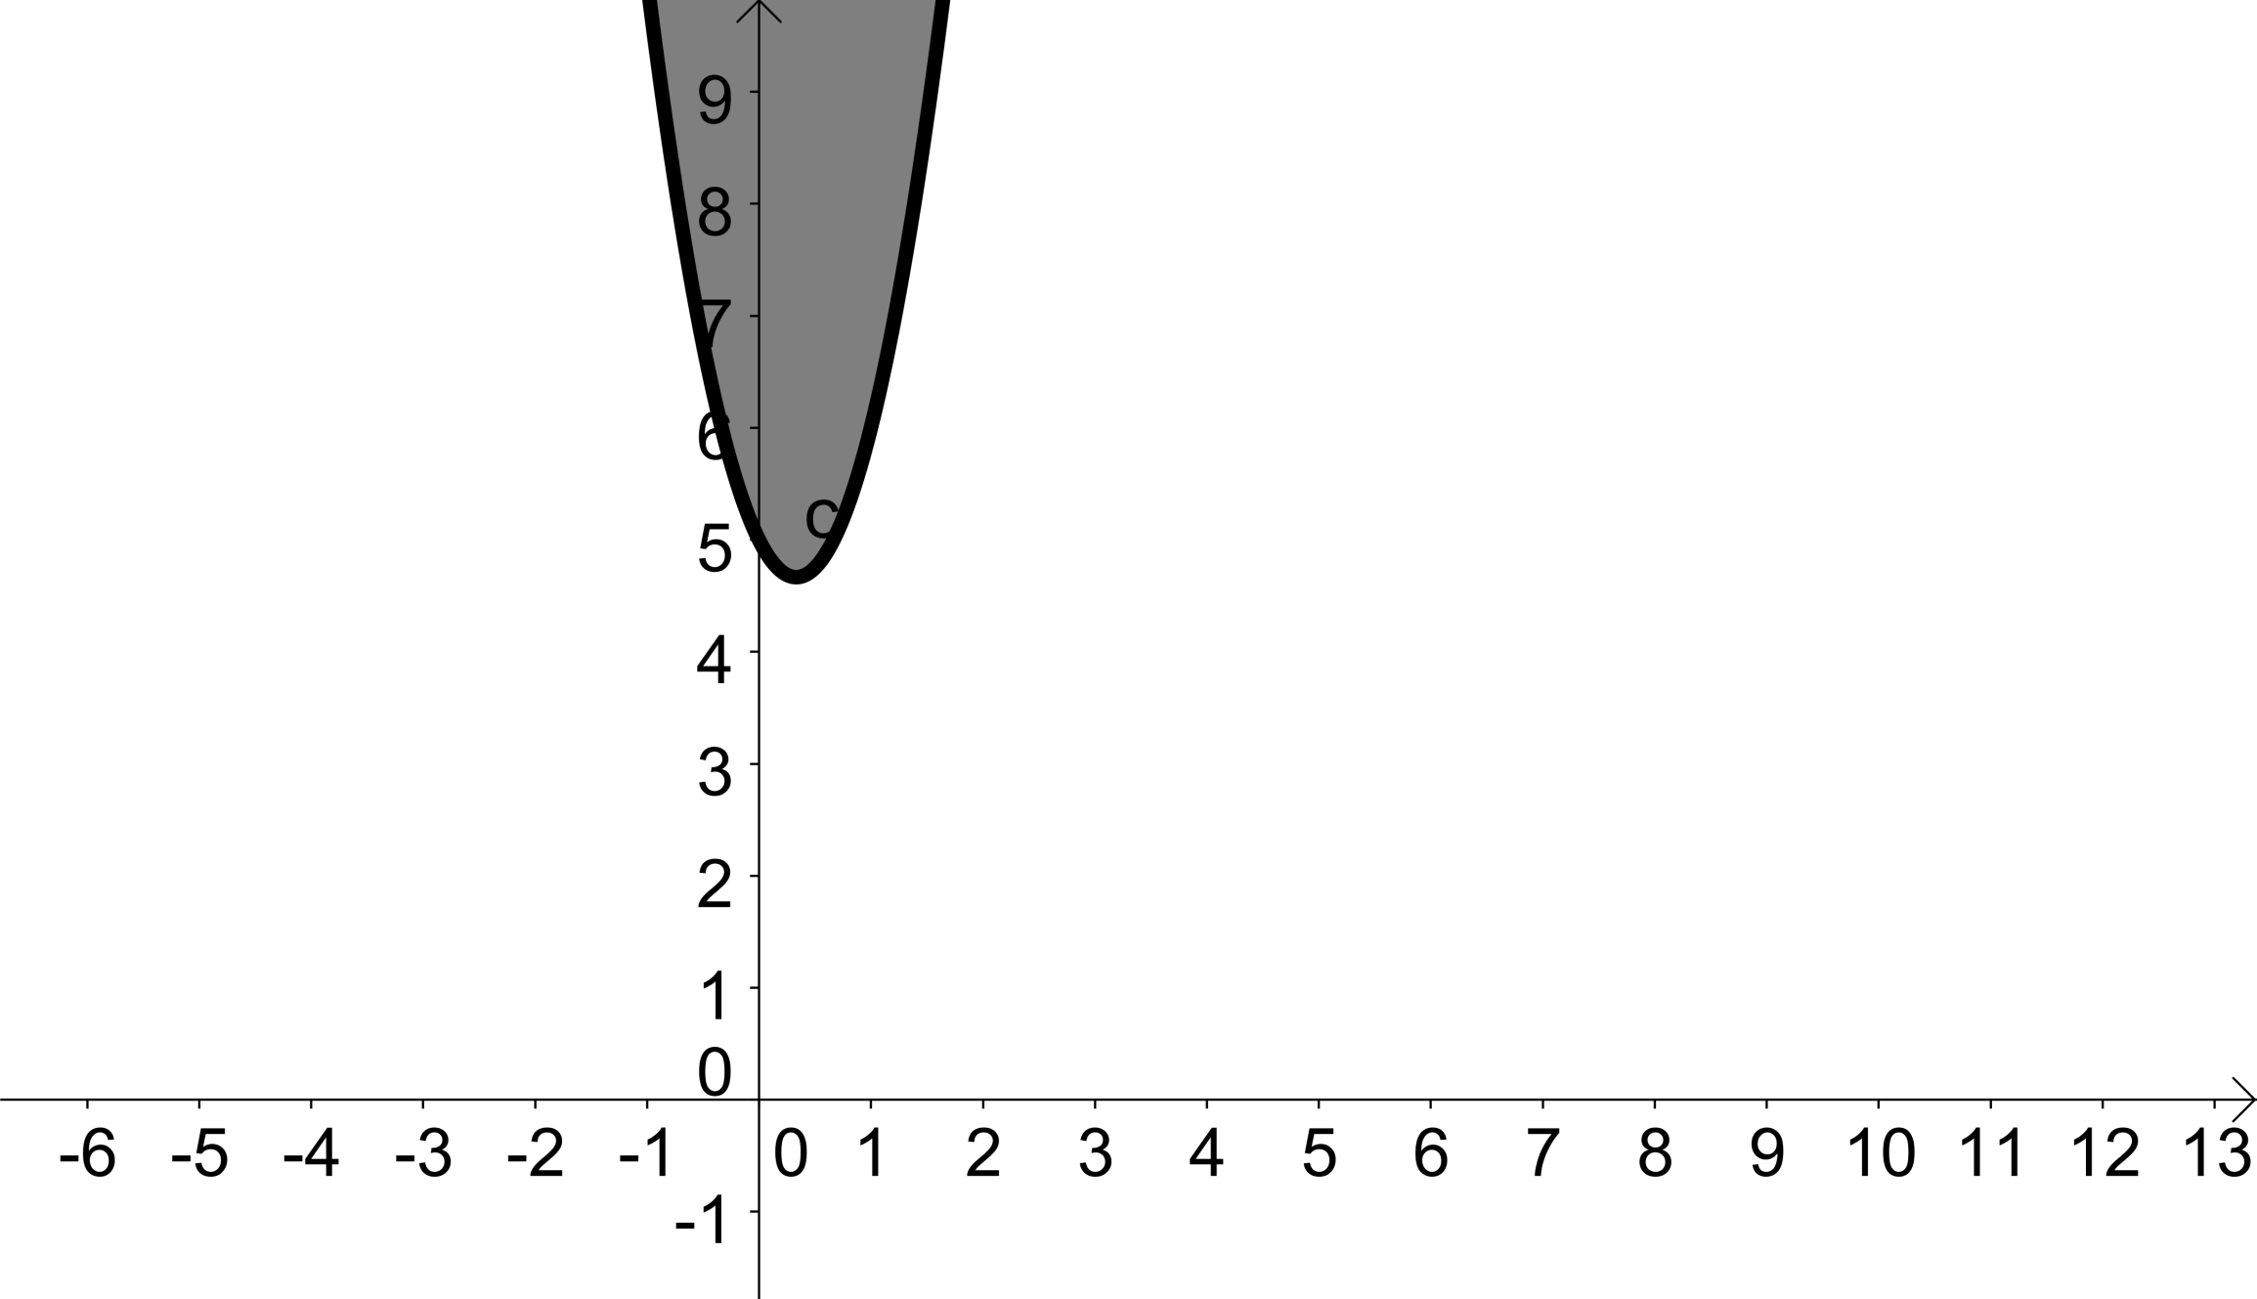

Slide 11
But this graph doesn’t cut through the x-axis at all................
WHY?
Try solving this algebraically to see what happens
What happens when we can’t find the factors?

Slide 12
Use the Quadratic Formula

Slide 13
A =
B =
C =
Filling in we get................

Slide 14
What is the
Why can a minus number NEVER have a square root?
What does squaring a number always mean?

Slide 15
So, if we can’t get the square root of a negative number, then we can conclude that this type of equation has no roots. In other words, there are no x – values which will make our function = 0.
We can use part of the quadratic formula to help us determine the nature of the roots of a quadratic equation.

Slide 16
Two Equal Real Roots

Slide 17
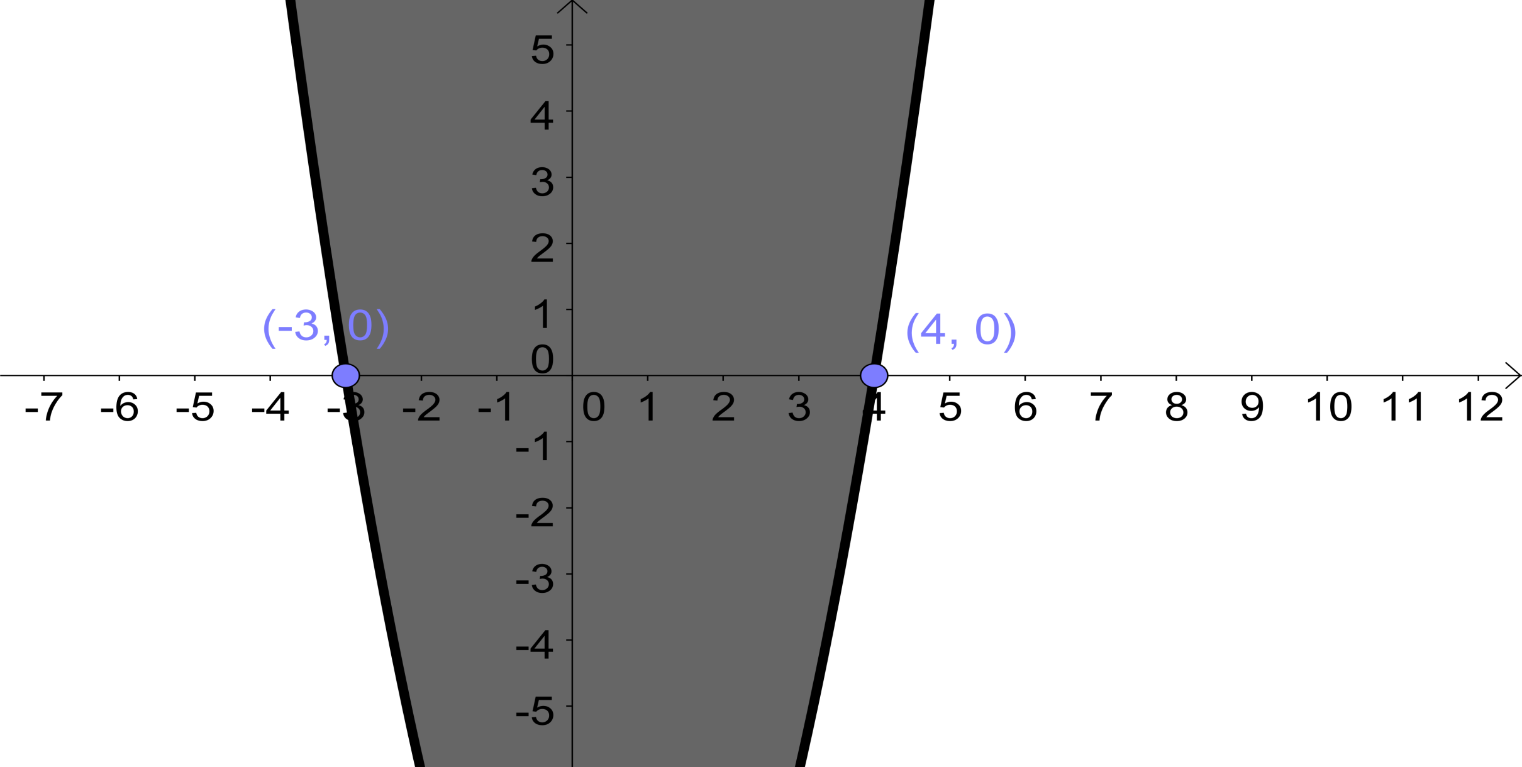
Two Different Real Roots

Slide 18
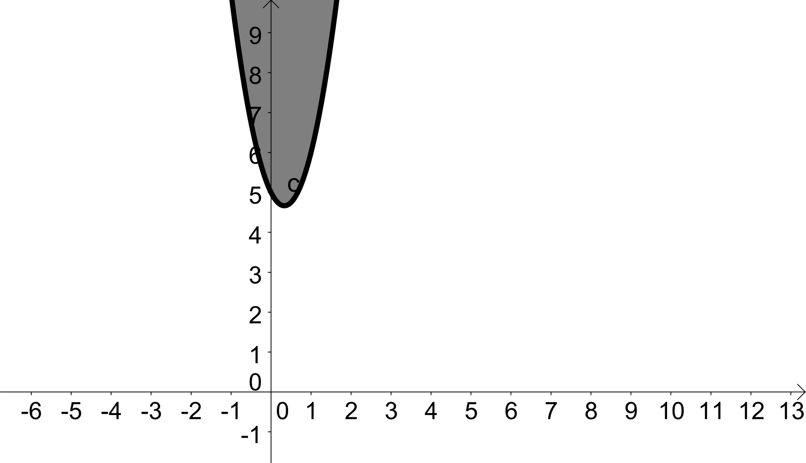
No Real Roots

Slide 19
Using the Quadratic Formula
We only need to concentrate on the stuff underneath the square root sign in the formula, ie. This is called the discriminant of the formula.

Slide 20
Nature of the Roots
Discriminant | Nature of Solutions
Zero | One Root
Positive | Two different real solutions
Negative | No Real Solutions

