Slide 1
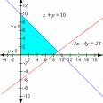
Class Rousseau Mr Duffy
October 2008
Co-ordinate Geometry of the Line 2

Slide 2
Midpoint Revision
Formula to use is
Remember:
1. Label points as normal
2. Write out the formula
3. Sub in as normal
4. Solve using your calculator
5. Be careful with minus signs
6. NEVER EVER EVER EVER add the two numbers at the end. They must be a point in the form (x , y) .

Slide 3
Any issues with your homework?
Please ask now!

Slide 4
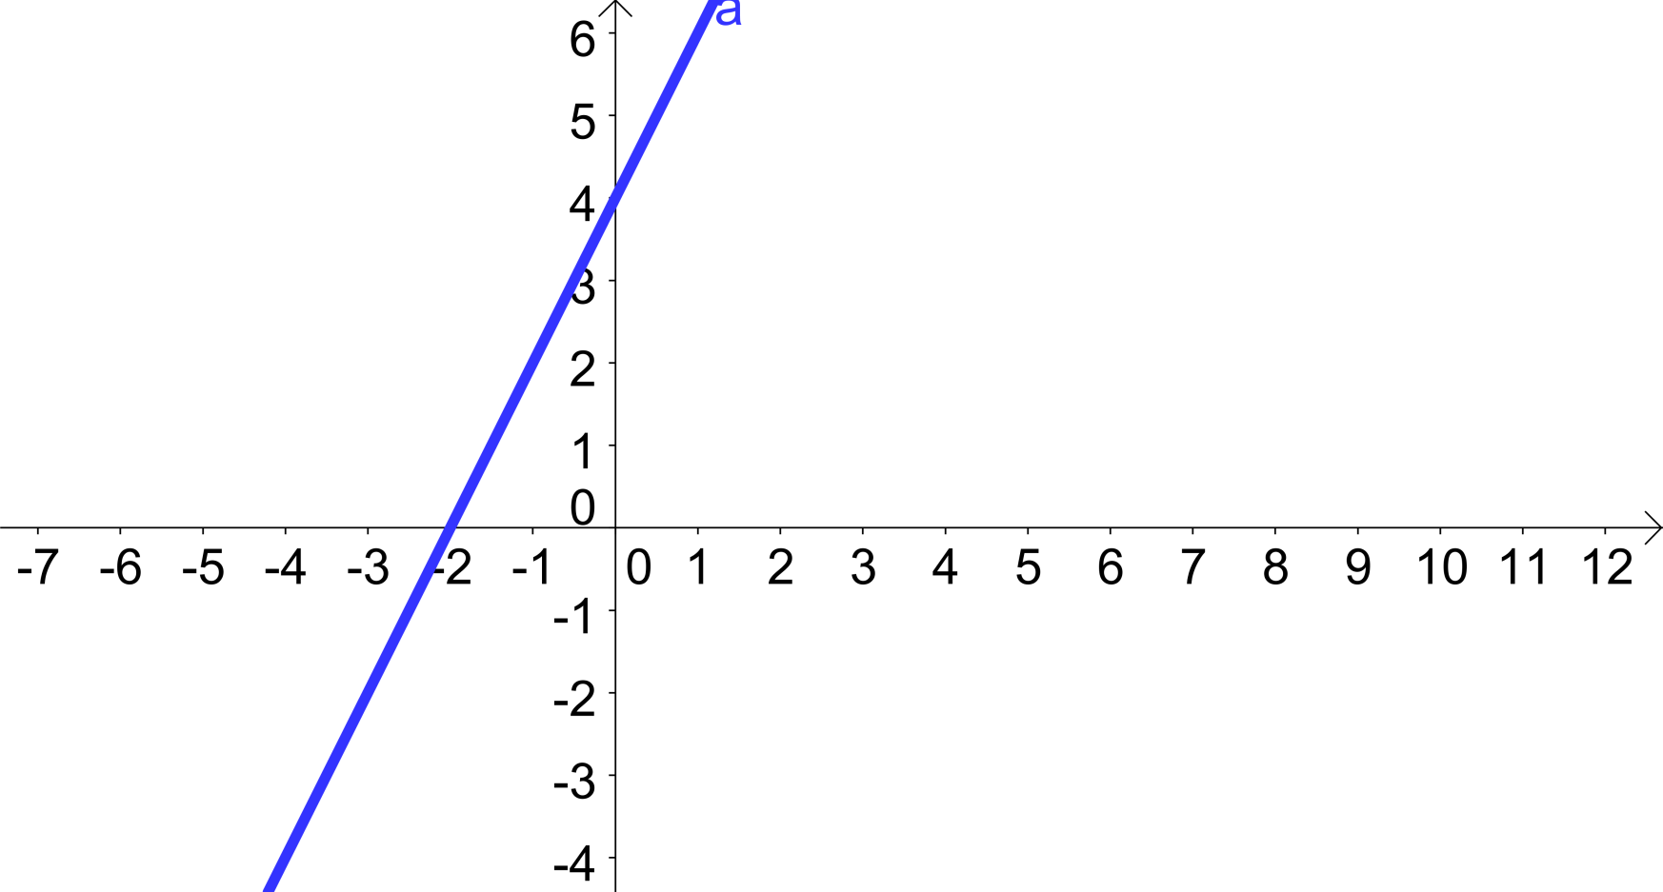
Slope of a line
What does the slope of a line mean?
Look at the following diagrams to see what’s going on.

Slide 5
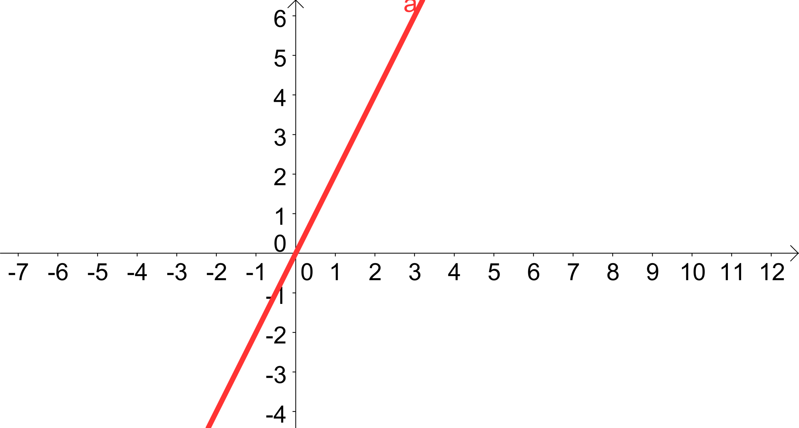

Slide 6
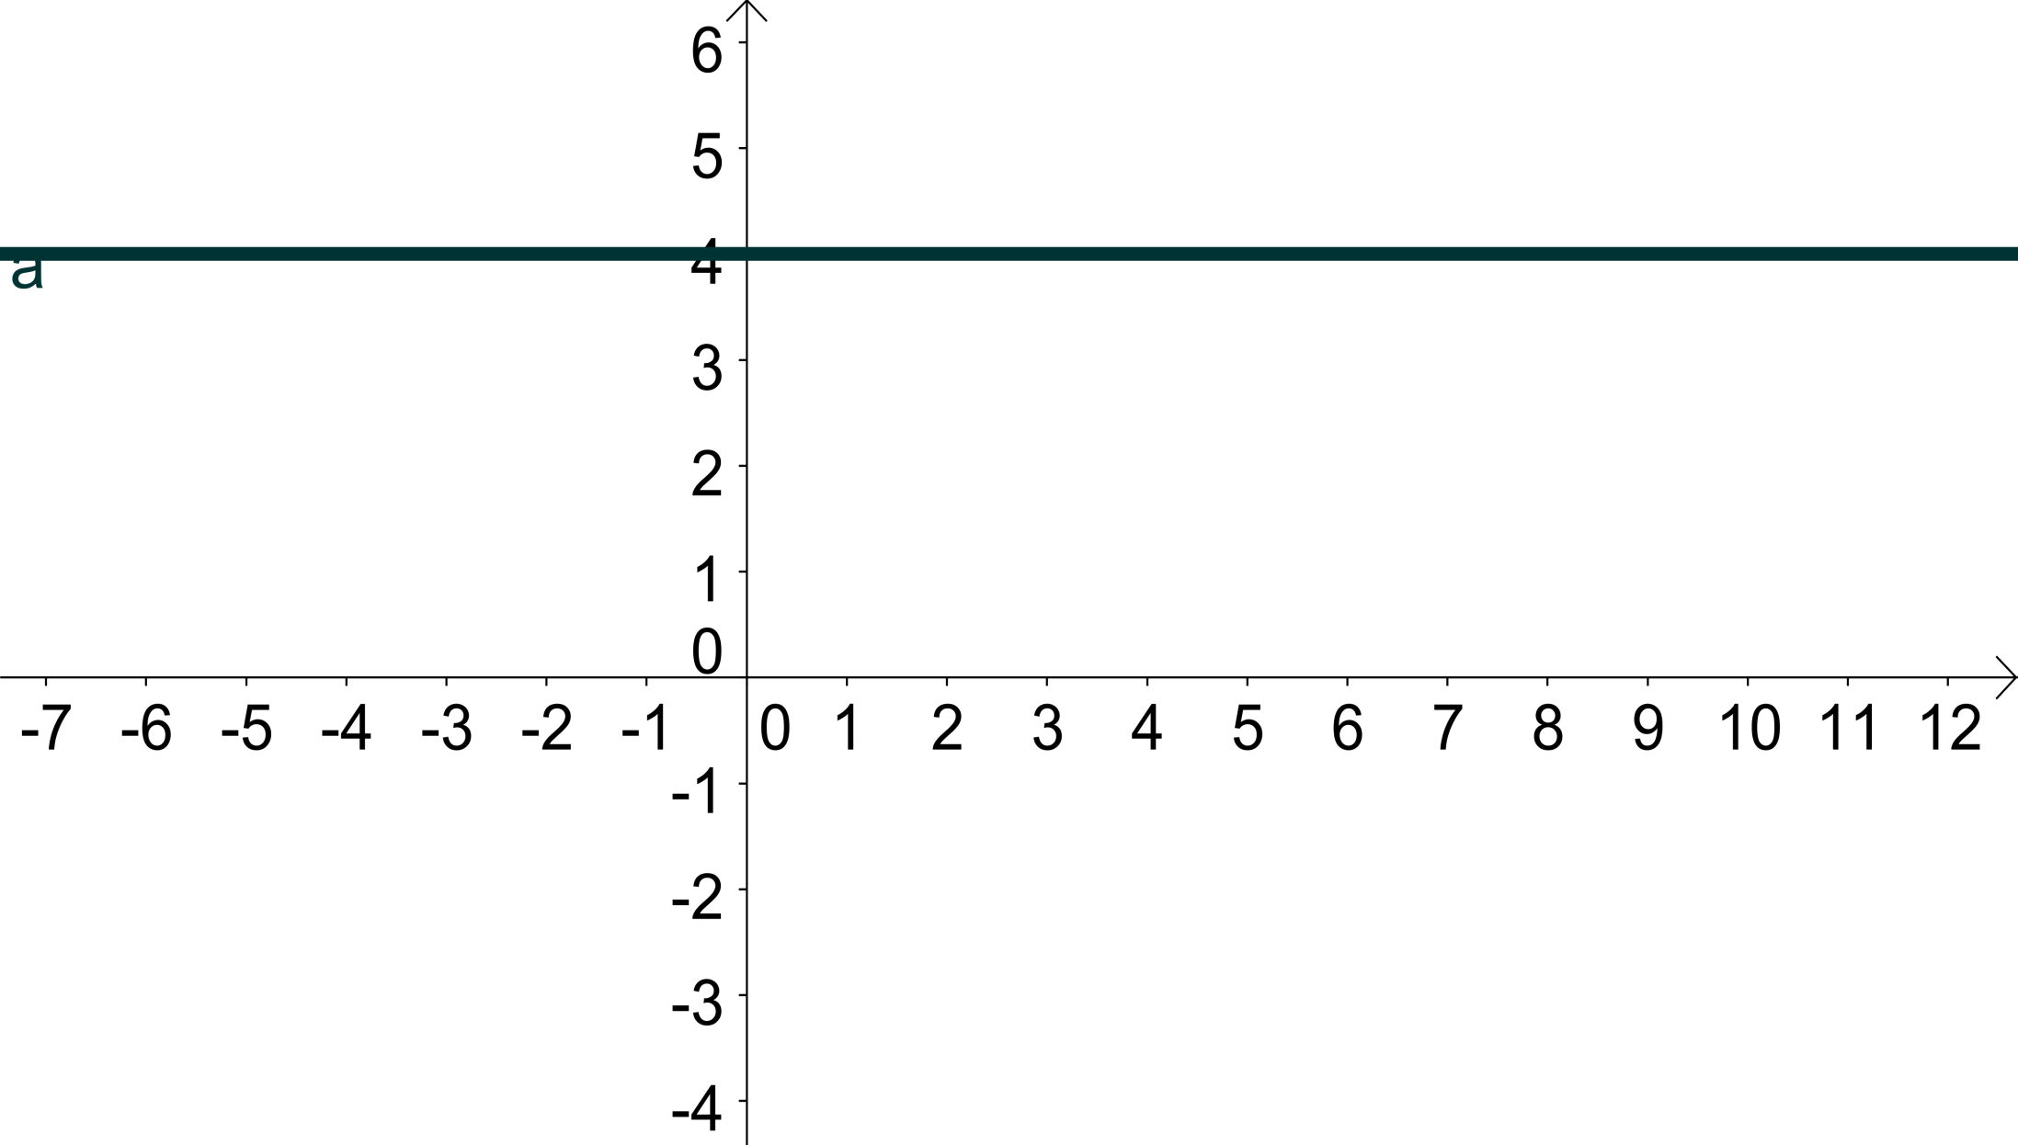

Slide 7
Slope Formula
Again, we can calculate the slope of a line using a formula which is very like the ones we’ve used up to now. The formula is...............

Slide 8
Steps involved
1. Write out formula
2. Label Points
3. Sub in and solve
4. Be careful with minus signs

